Slide 1

Secure IoT in the
Era of Quantum Computers
An In-Depth Performance Analysis of Post-Quantum
Cryptography (PQC) in Low-Power IoT
Citation: Schöffel, M., Lauer, F., Rheinländer, C.C., & Wehn, N. (Sensors 2022).
Gonapa Shiva Teja
Electrical And Computer Eng
Shiv Nadar University Delhi NCR

Slide 2
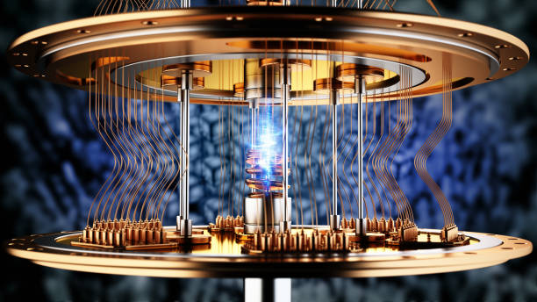
Problem Statement & System Challenges
The Cryptographic Crisis:
Shor’s Algorithm breaks standard RSA and ECC (NIST P-256) in polynomial time.
Solves prime factorization and discrete logarithms instantly on quantum hardware.
The "Store Now, Decrypt Later" Threat:
Adversaries passively harvest encrypted Industrial IoT (IIoT) traffic today.
Target: Decrypt sensitive long-lifecycle telemetry data in the 2030s.
The Resource Ceiling:
Post-Quantum Cryptography (PQC) shifts to complex math
(e.g. Lattice geometry).
Drastically expands public key, ciphertext, and digital signature sizes.
The Key-Size Explosion (Core Dilemma):
Legacy ECC (NIST P-256): Only 32 Bytes
Post-Quantum (Lattice-Based): Thousands of Bytes (1KB to 10kb+).
Central Research Question:
Can resource-constrained microcontrollers handle a full operational network protocol stack under this massive data overhead, or are custom hardware accelerators mandatory?

Slide 3
Experimental Setup & Evaluation Testbed
Edge Node Hardware Configuration:
Client: Nordic Semiconductor nRF52840 SoC containing a 32-bit ARM Cortex-M4 MCU running @ 64MHz.
Memory footprint constraint: 256 KB RAM and 1 MB Flash ROM (The official NIST reference platform).
Server Infrastructure:
High-performance Linux Server running an optimized, quantum-safe library environment (OQS-OpenSSL).
Full Production-Grade IoT Protocol Stack:
MQTT (12-Byte Payload) ➔ TLS 1.2 (Cryptographic Handshake) ➔ TCP ➔ 6LoWPAN (Adaptation Layer) ➔ BLE (Physical Link Layer)
Software Implementation Framework:
Integrated speed-optimized assembly language primitives from the pqm4 library into the lightweight mbedTLS architecture.
High-Precision Physical Profiling:
Multi-channel energy and timing tracking executed dynamically via a Nordic Power Profiler Kit 2 (PPK2).
Calibration and validation conducted with an ultra-high-resolution Keithley DMM7510 digital multimeter.

Slide 4
Key Findings – The True System Bottleneck
The Computational Paradigm Shift:
Myth: Post-Quantum Cryptography (PQC) mathematical calculations are too computationally heavy for low-power microcontrollers.
Reality: The 32-bit ARM Cortex-M4 CPU handles lattice-based math algorithms (like Kyber and Saber) with high efficiency. Processing math is NOT the primary system bottleneck.
The Network Bandwidth Crisis:
The actual bottleneck is Data Volume and Packet Transmission.
Large PQC public keys, ciphertexts, and digital signatures far exceed the standard Maximum Transmission Unit (MTU) size of constrained network layers.
Severe Packet Fragmentation:
A single post-quantum public key cannot fit into a standard low-power radio packet.
This forces massive packet fragmentation at the 6LoWPAN adaptation layer and Bluetooth Low Energy (BLE) link layer.
The Radio Energy Drain (The Core Performance Cost):
To transmit dozens of small packet fragments, the physical wireless radio must stay active in high-power Tx/Rx modes for extended durations.
The Takeaway: Keeping the wireless radio turned on longer to transmit fragmented keys drains significantly more battery energy (mJ) than the CPU executing the cryptographic math.

Slide 5
Key Findings – Heterogeneous PKIs & Battery Impact
The Homogeneous Benchmark Dilemma:
Implementing a single, uniform algorithm family across the entire Public Key Infrastructure (PKI) introduces severe operational penalties.
Dilithium2: Fast mathematical execution, but massive key/signature sizes create a 4x network latency penalty during over-the-air packet transmission.
Falcon512: Small network bandwidth footprint, but requires a highly complex, CPU-intensive mathematical verification loop on the client side.
The Solution: Heterogeneous Public Key Infrastructures:
The authors discovered that combining different algorithms based on asymmetrical architectural strengths yields maximum efficiency.
The Optimal Post-Quantum Mix: Deploy Falcon certificates on the server-side (minimizes over-the-air payload size) + Di-lithium signatures on the client edge node (minimizes client-side RAM and compute overhead).
Energy Reduction: This targeted, heterogeneous approach drops total handshake energy consumption by 30% compared to a purely uniform setup.
Real-World Battery Uptime Metrics:
Tested under a standard industrial IoT scenario: 3.6V, 1.2Ah Lithium Cell executing encrypted transactions.
The Verdict: An optimized hybrid configuration (Kyber512 + Falcon512) delivers a physical node lifespan of up to 10 years while performing 200+ secure transmissions per day.

Slide 6
Limitations, Gaps, & Future Scope
Memory and Library Constraints:
Speed-optimized assembly code from the open-source pqm4 library required massive static RAM allocations.
This exceeded the 256 KB memory ceiling of the Cortex-M4, forcing a fallback to slower standard NIST reference code for Digital Signatures.
Network Protocol Framework Limitations:
Benchmarks were evaluated strictly using TLS 1.2 because stable, embedded TLS 1.3 libraries (mbedTLS) were unavailable during the study.
The Omission: TLS 1.3 eliminates network round-trips during handshakes, which remains an unmeasured variable.
Algorithmic Exclusions:
Ultra-large PQC candidates (such as Classic McEliece, with public keys exceeding hundreds of Kilobytes) were completely excluded as they cannot physically fit into IoT microcontroller RAM.
Strategic Future Scope (Your Internship Runway):
Protocol Upgrades: Porting the experimental benchmarking stack onto an updated TLS 1.3 environment.
Memory Optimization: Engineering low-RAM, memory-pruned assembly primitives for Falcon and Dilithium to eliminate static buffer bloat.
Network Compression: Evaluating 6LoWPAN header or packet compression mechanisms to systematically reduce physical wireless radio uptime.

Slide 7
Technical Nomenclature & Architectural Glossary
1. Cryptographic Primitives & NIST Candidate Schemes
PQC / KEM / DSA: Post-Quantum Cryptography / Key Encapsulation Mechanism / Digital Signature Algorithm.
Mod-LWE / LWE: Module Learning With Errors / Learning With Errors (The foundational geometric lattice problems protecting Kyber and Dilithium).
Kyber / Saber / NTRU: Lattice-based Key Encapsulation Mechanisms evaluated for quantum-safe key exchange.
Dilithium / Falcon / SPHINCS+: Lattice-based (Dilithium/Falcon) and Hash-based (SPHINCS+) digital signature algorithms evaluated for authentication.
BIKE / HQC / SIKE: Code-based (BIKE/HQC) and Isogeny-based (SIKE) alternative cryptographic algorithms evaluated in thepaper.
ECDHE / ECDSA: Elliptic Curve Diffie-Hellman Ephemeral / Elliptic Curve Digital Signature Algorithm (Legacy, quantum-vulnerable protocols).
2. Hardware & Benchmarking Architecture
MCU / SoC: Microcontroller Unit / System on Chip.
ARM Cortex-M4: The 32-bit RISC processor hardware architecture used as the constrained IoT edge client.
PPK2 / DMM: Nordic Power Profiler Kit 2 / Digital Multimeter (Keithley DMM7510) (Physical energy profiling hardware).
3. Network & Library Protocol Stack
MQTT: Message Queuing Telemetry Transport (Lightweight Application Layer Data Protocol).
TLS 1.2: Transport Layer Security protocol version 1.2 (Session Cryptographic Handshake Layer).
6LoWPAN: IPv6 over Low-Power Wireless Personal Area Networks (Network Adaptation Layer for packet fragmenting).
BLE / MTU: Bluetooth Low Energy / Maximum Transmission Unit (The physical radio link layer and its strict packet size limit).
mbedTLS / pqm4: Embedded-optimized TLS library integrated with speed-optimized assembly-level PQC math primitives.
OQS-OpenSSL: Open Quantum Safe OpenSSL framework running on the backend Linux Server architecture.

Slide 8
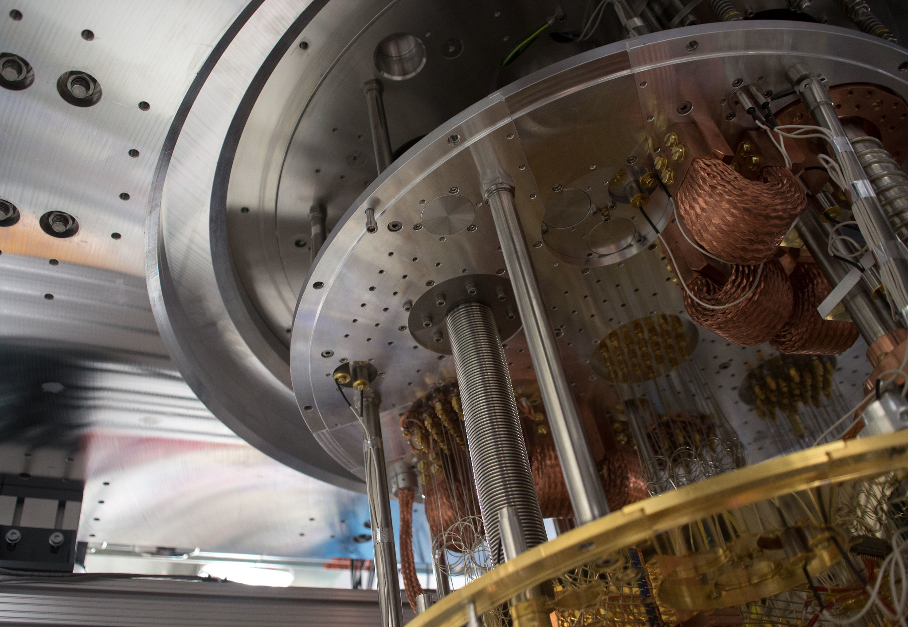
Thank you
Gonapa Shiva Teja
Electrical And Computer Eng
Shiv Nadar University Delhi NCR

